Slide 1
PPP & HDLC

Slide 2
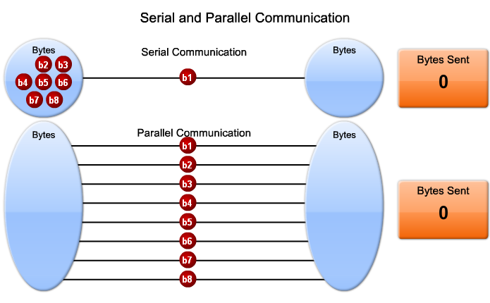
Serial connection

Slide 3
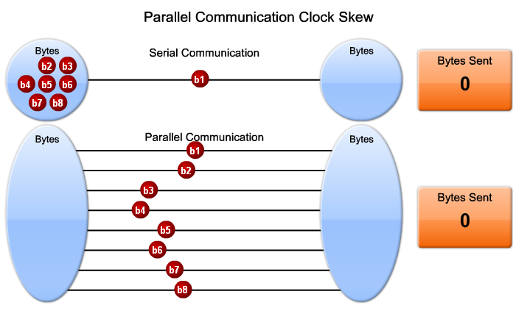
Serial connection

Slide 4
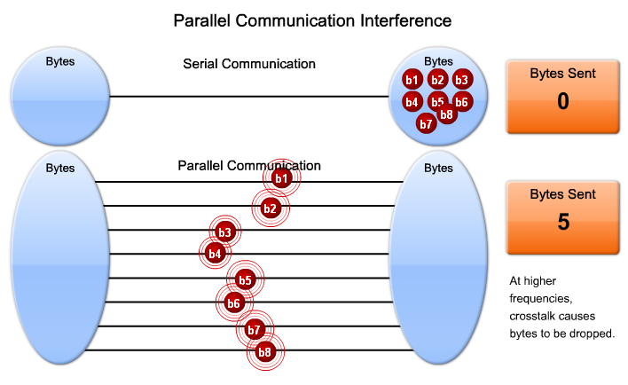
Serial connection

Slide 5
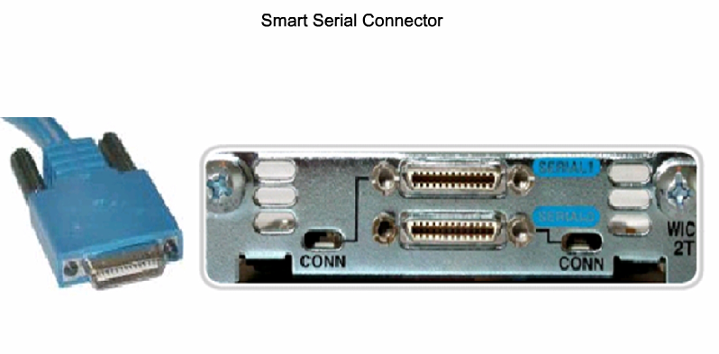
Smart Serial

Slide 6
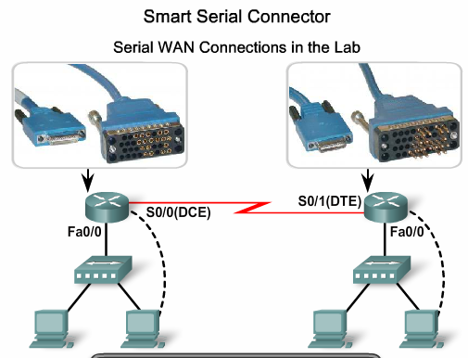
Smart Serial connector

Slide 7
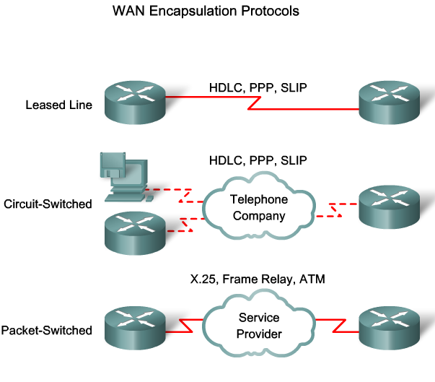
Wan encapsulation protocol

Slide 8
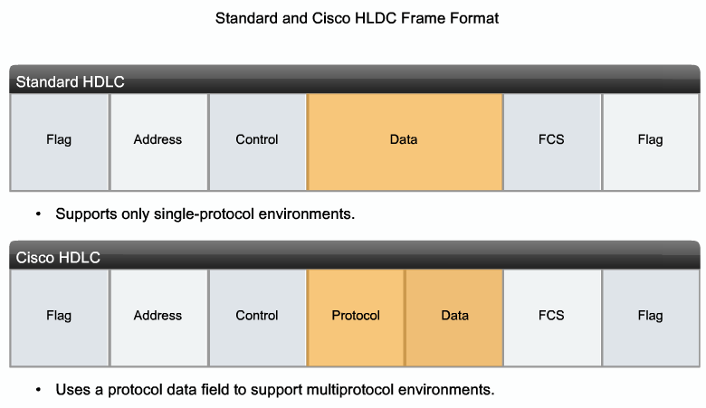
HDLC

Slide 9
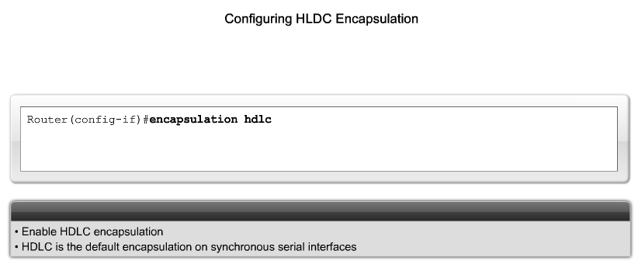
HDLC

Slide 10
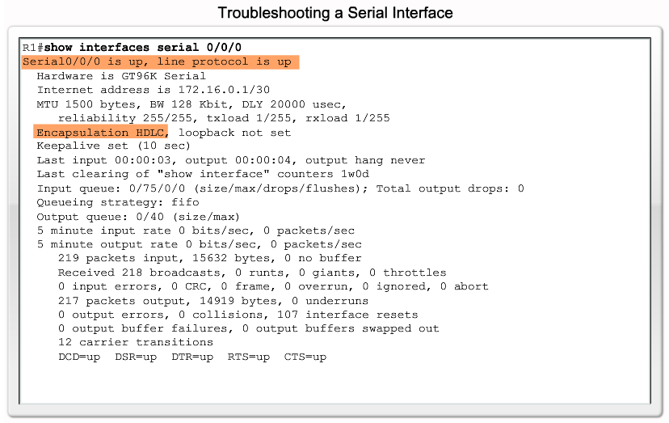
HDLC

Slide 11
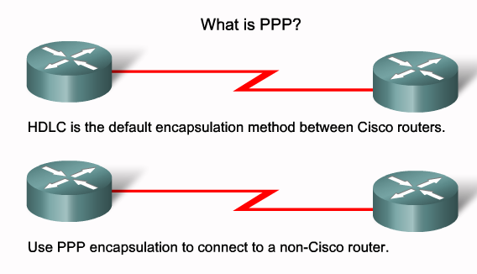
PPP

Slide 12
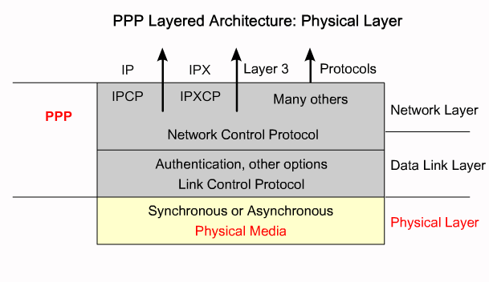
PPP PHYSICAL LAYER

Slide 13
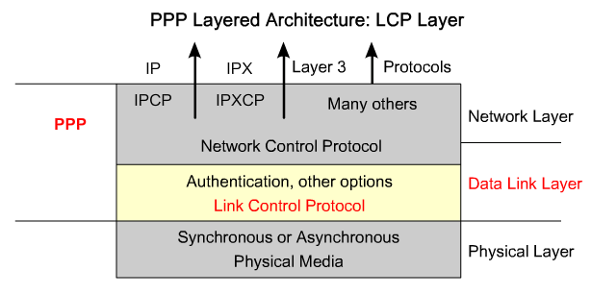
LCP

Slide 14
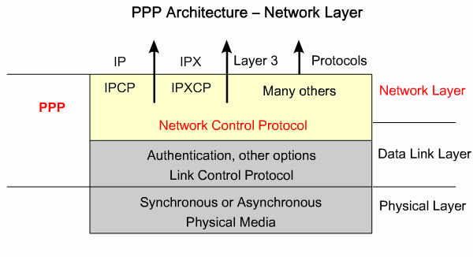
NCP

Slide 15
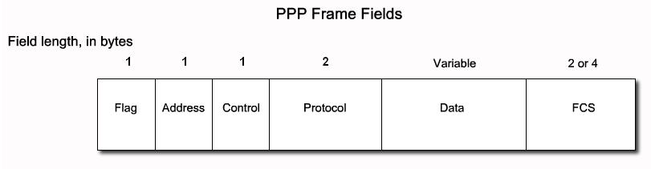
PPP

Slide 16
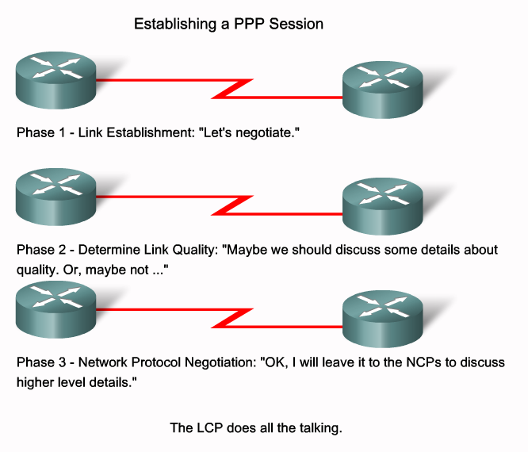

Slide 17
PPP components
1- Frame Format:
2- Link control protocol (LCP):
  It negotiates : 1.Link establishment →open session
2.Link management →options
3.Link termination.
3- Network control protocol (NCP):
  Negotiates the upper layer protocols that will be transmitted across the ppp connection.
Flag | address | control | type | data | FCS flag

Slide 18
PPP LCP Features
Compression
Multilink PPP
Call Back
Authentication

Slide 19
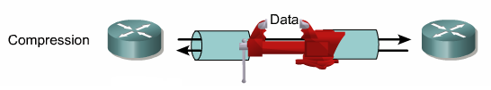
1- Compression
To improve the throughput on slower links.

Slide 20
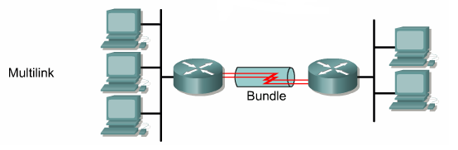
2- Multilink
B.W aggregation by combining multiple physical interfaces into one link (logically) like load sharing.
Splitting L3 packets into small parts called fragments and send tem over parallel links.
This can improve throughput and reduce latency between systems.

Slide 21
3- Call back
Enable a router to place a call and request call back (Like missed calls).
Once the request is made, the call disconnect and the other router (server) dial the router (client) back.
By that way a central site can pay all the bills of the calls with the other sides.

Slide 22
4- Authentication
Authentication means to put a username and password before accessing the network.
There is two authentication protocols:
  PAP (PPP Authentication Protocol).
  CHAP (Challenge Handshake Authentication
  Protocol).

Slide 23
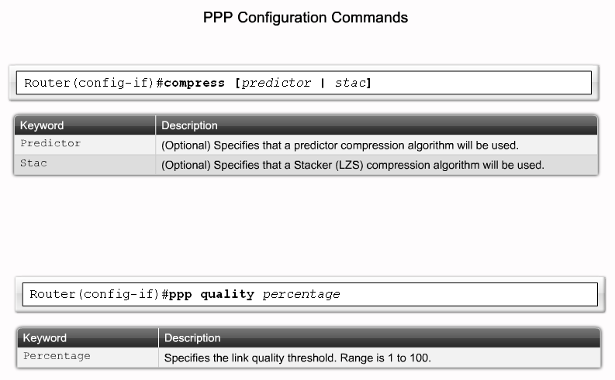
PPP

Slide 24
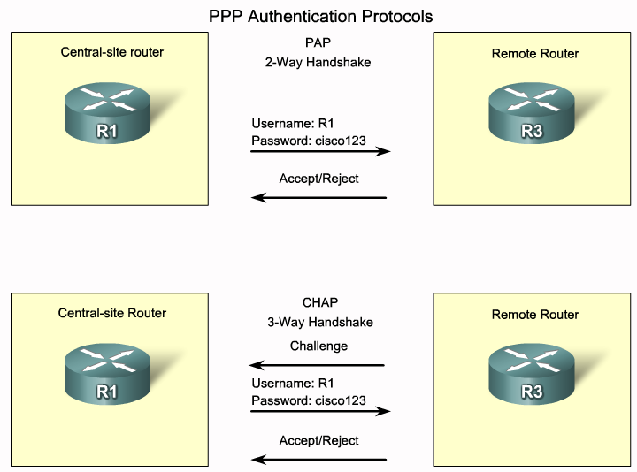
PPP AUTHENTICATION

Slide 25
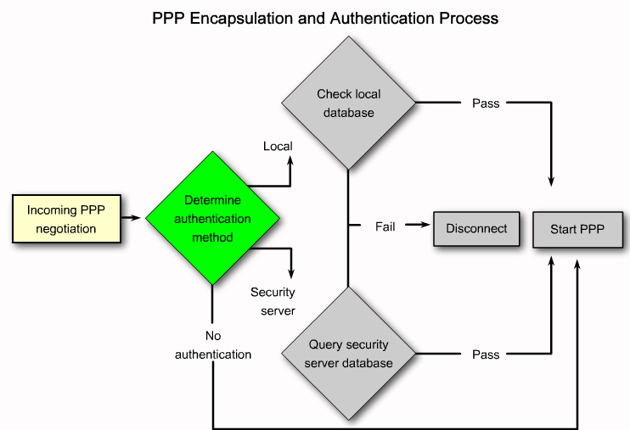
AUTHENTICATION PROCESS

Slide 26
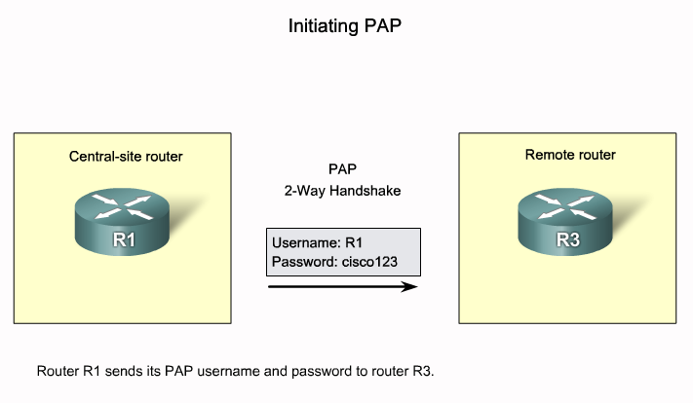
PAP

Slide 27
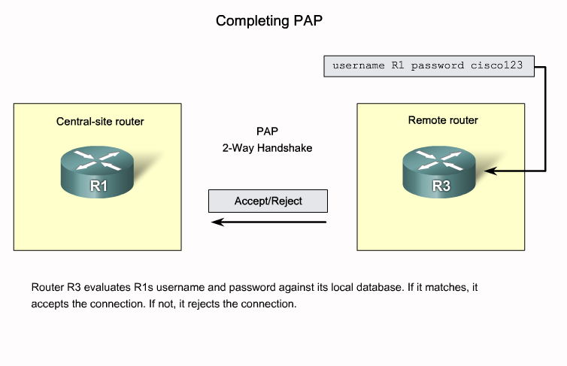
PAP

Slide 28
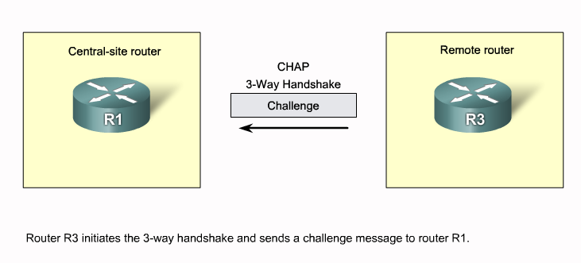
CHAP

Slide 29
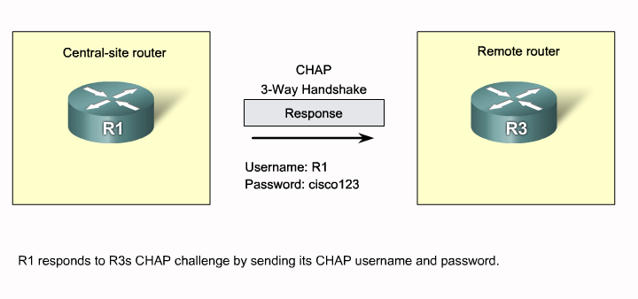
CHAP

Slide 30
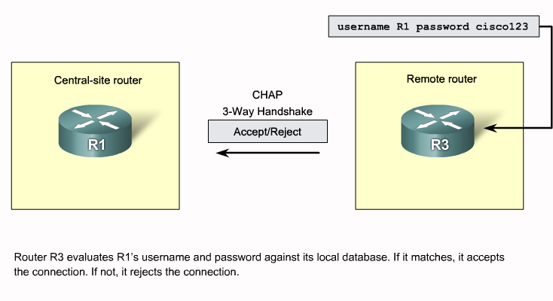
CHAP

Slide 31
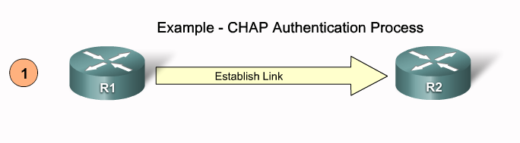
CHAP PROCESS

Slide 32
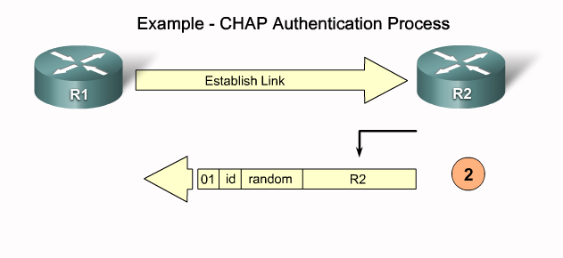
CHAP PROCESS

Slide 33
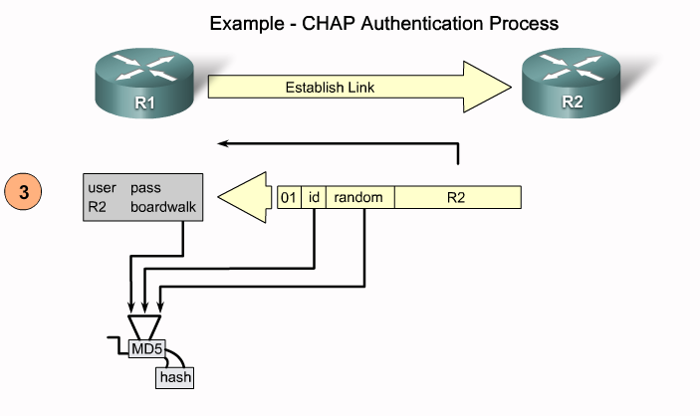
CHAP PROCESS

Slide 34
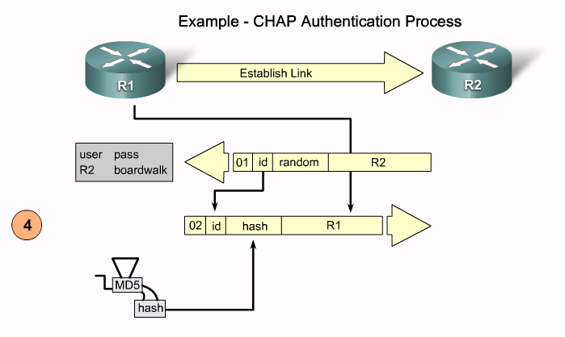
CHAP PROCESS

Slide 35
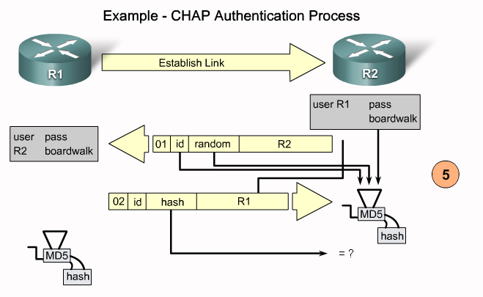
CHAP PROCESS

Slide 36
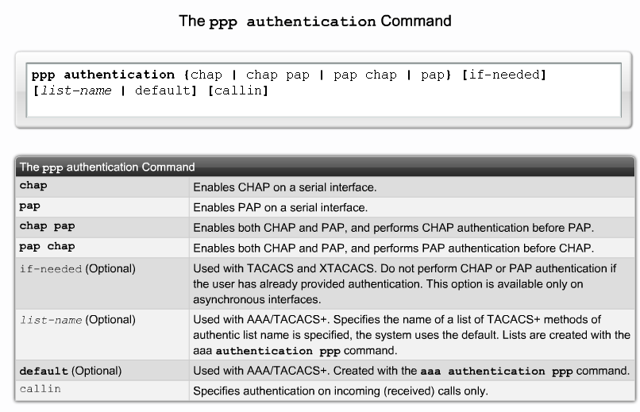

Slide 37
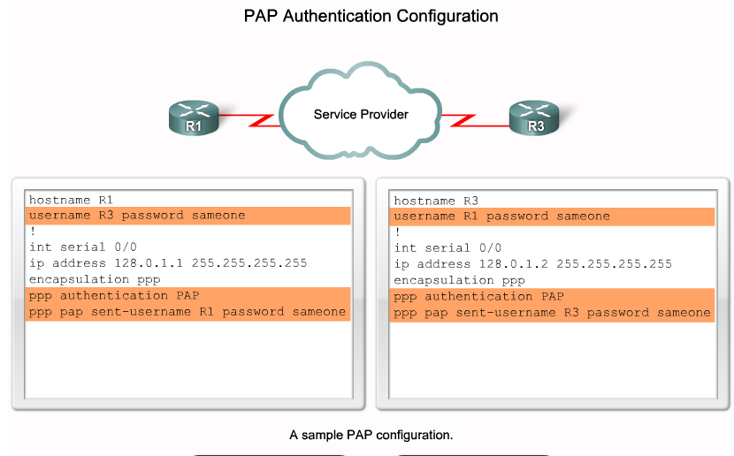
PAP AUTHENTICATION

Slide 38
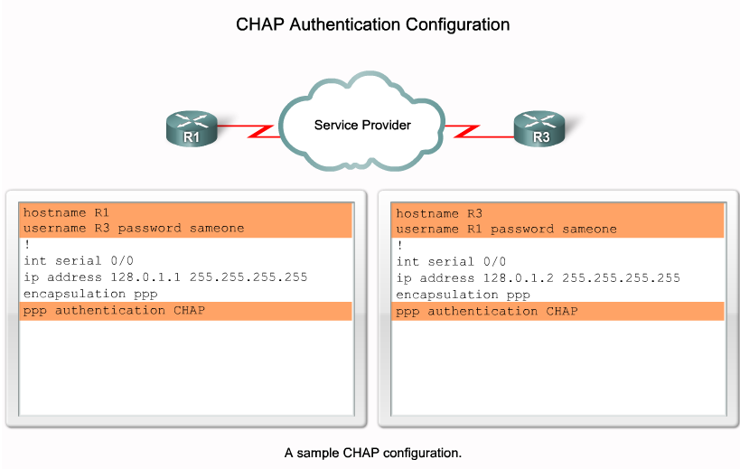
CHAP AUTHENTICATION

Slide 39
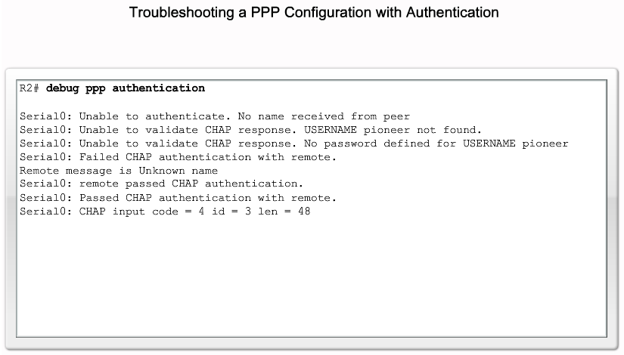
CHAP DEBUG

Slide 40
Troubleshooting
# show int s0/0.
The status of interface, encapsulation, LCP state, NCP state.
#debug ppp negotiation.
#debug ppp authentication.

